Slide 1
Introduction to ML in Business
Hasan AVCI
INZVA – APPLIED AI #7

Slide 2

Fırst Thıngs fıRst
What I am as ML Engineer:
Machine Learning Engineer in Business
Expertise in building ML products for business
Understanding business problems
Reaching agreements with business stakeholders
Building scalable ML solutions
Implementing APIs or ETL processes
Maintaining ML product
What I am not:
Software engineer
ML Researcher
Network expert
CI/CD etc. best practicer
Network designer
Cloud Expert

Slide 3
Course GOAL
« Aims to provide a comprehensive understanding of the role and responsibilities of ML engineers in business settings, covering workflow, tools, product lifecycle, and maintenance. »
Main Goals:
Precisely outline the expectations and responsibilities of ML engineers within a company.
Demonstrate the workflow and collaboration processes within Data Science teams in a corporate setting.
Introduce fundamental tools, frameworks, and technologies utilized by ML engineers.
Examine the lifecycle and fundamental components of Machine Learning Products in business scenarios.
Assist participants in developing and delivering ML Products, spanning from problem identification to model deployment, fostering collaborative model deployment.
Discuss best practices for maintaining and enhancing ML Products throughout their lifecycle.

Slide 4
What Is AN ML Product
«A Machine Learning Product is a software application or system that utilizes machine learning algorithms and techniques to analyze and process data, make predictions, automate tasks, or provide intelligent insights, ultimately solving real-world problems. »

Slide 5
Examples
Fraud Detection System: Machine learning models can be trained to identify patterns and anomalies in financial transactions, helping to detect fraudulent activities in real-time.
Recommendation Engine: By leveraging user data and behavior, machine learning algorithms can generate personalized recommendations for products, movies, music, or content, enhancing user experience and driving engagement.
Medical Diagnosis System: Machine learning models can assist doctors in diagnosing diseases by analyzing patient data, medical history, and symptoms to provide accurate predictions and potential treatment plans.
Natural Language Processing (NLP) Chatbot: NLP algorithms combined with conversational AI techniques enable chatbots to understand and respond to user queries, providing automated customer support or virtual assistants.
Image Recognition System: Machine learning models can classify and recognize objects, scenes, or faces in images, enabling applications such as autonomous vehicles, facial recognition systems, or content moderation tools.

Slide 6
LIFECYCLE OF an ML PRODUCT
Problem Definition: Understand the business problem or user needs that the ML product aims to address and define clear objectives and success metrics.
Data Acquisition and Preparation: Gather relevant data from various sources, clean and preprocess it, and perform feature engineering to extract meaningful patterns and insights.
Model Development: Select suitable ML algorithms, train and evaluate models using appropriate techniques such as cross-validation, hyperparameter tuning, and performance metrics optimization.
Model Deployment: Integrate the trained model into a production environment, ensuring scalability, reliability, and security. Implement APIs, user interfaces, or backend systems for real-time predictions or batch processing.
Monitoring and Maintenance: Continuously monitor the performance of the ML product, gather feedback, and iteratively improve the model or system. Address issues, retrain models with updated data, and handle model drift or concept shifts.
Lifecycle Management: Periodically assess the ML product's effectiveness, reevaluate business objectives, and consider updates, enhancements, or retirement based on changing requirements, market conditions, or technological advancements.

Slide 7
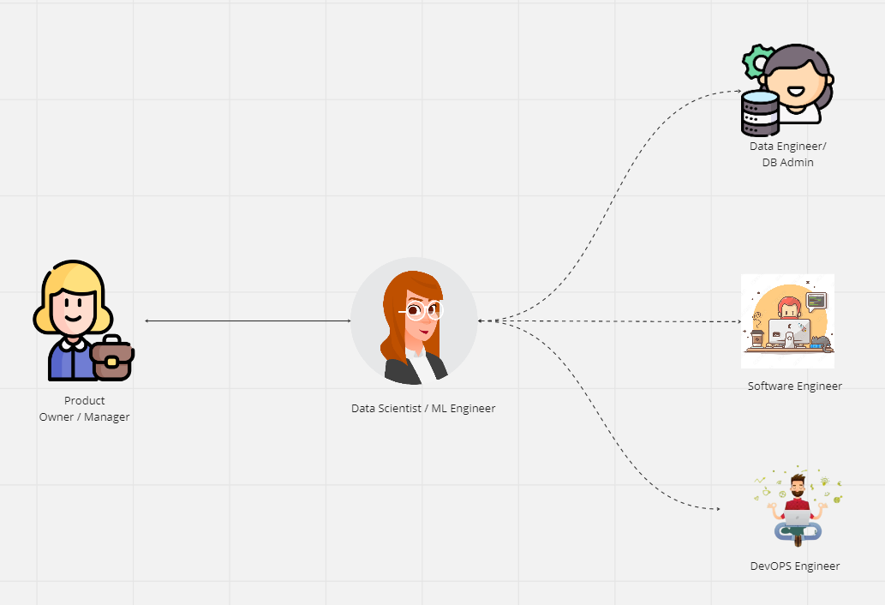
ML PRODUCT DEVELOPMENT WORKFLOW

Slide 8
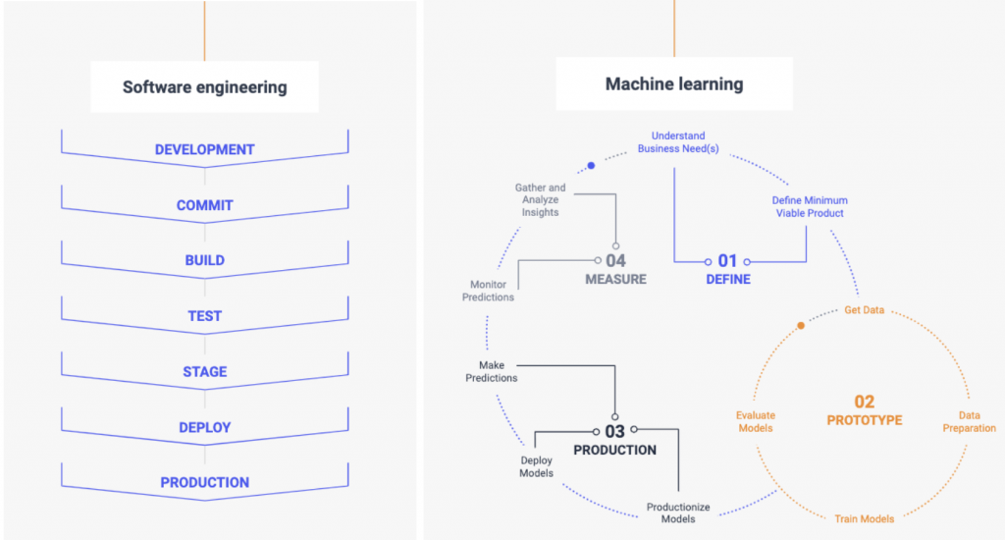
SoftWARE DEVELOPMENT vs ML PRODUCT DeV.

Slide 9
TOOLSET USED ın busıness FREQ.
Business & Workflow Management:
Atlassian Jira: https://www.atlassian.com/jira
Atlassian Confluence: https://www.atlassian.com/software/confluence
Miro Board: https://miro.com/
FigJam: https://www.figma.com/figjam/team-collaboration/
Slack: https://slack.com/
Agile Frameworks: Scrum, Kanban

Slide 10
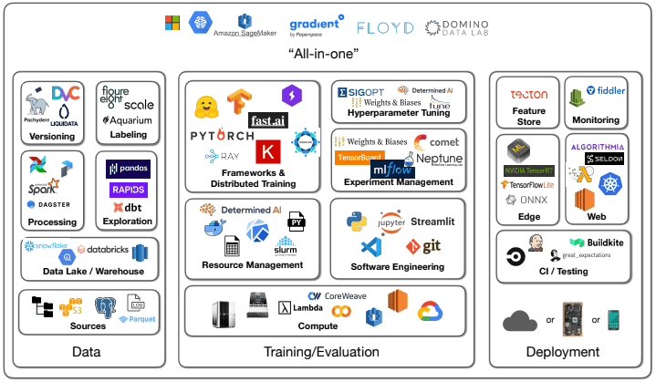
TOOLSET USED ın busıness FREQ.
https://mlops.community/mlops-is-a-mess-but-thats-to-be-expected/

Slide 11
ML In Busıness vs ML IN RESEARCH & YOUTUBE
Data is ready and easy.
Implementing ML Algorithms is the most needed.
SOTA models are cooler.
Free to run on Colab.
Use everything available on the Internet
Torture the model until it speaks.
pip install
Works everywhere

